Slide 1
Coffee Business in Cairo
Coursera Capstone Project
AHMED SAFWAT EWIDA

Slide 2
Contents
01
Introduction
02
Data Scraping and Analysis
03
Methodology
04
Results

Slide 3

Introduction

Slide 4
Cairo, the city of lively nights and coffee shops
Establishing a business plan for a Coffee shop in Cairo is a very challenging Project. The city has a Population of more than 20 Million People, an extensive selection of tastes, a Diversity of Social classes and variety of Population density as its main features and attributes, which must be considered before selecting the location of your Coffee Shop.
This Project is to guide those interested in opening a coffee shop Business in Cairo, as they can find the suitable location among different locations in Cairo taking in consideration the density of population and number of available Coffee shops.

Slide 5
Data Scraping and Analysis

Slide 6
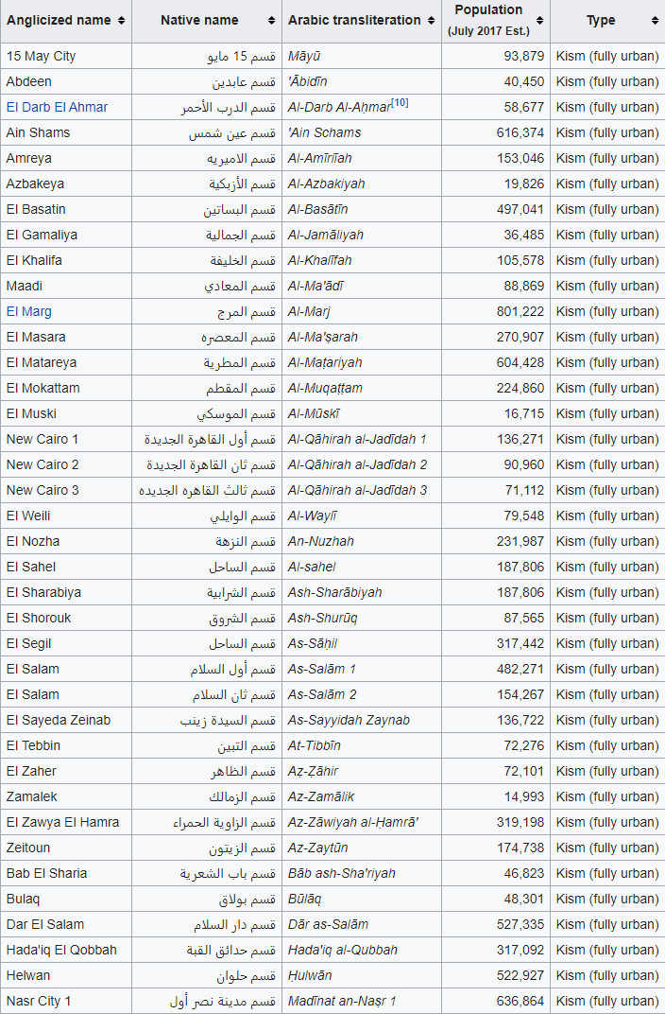
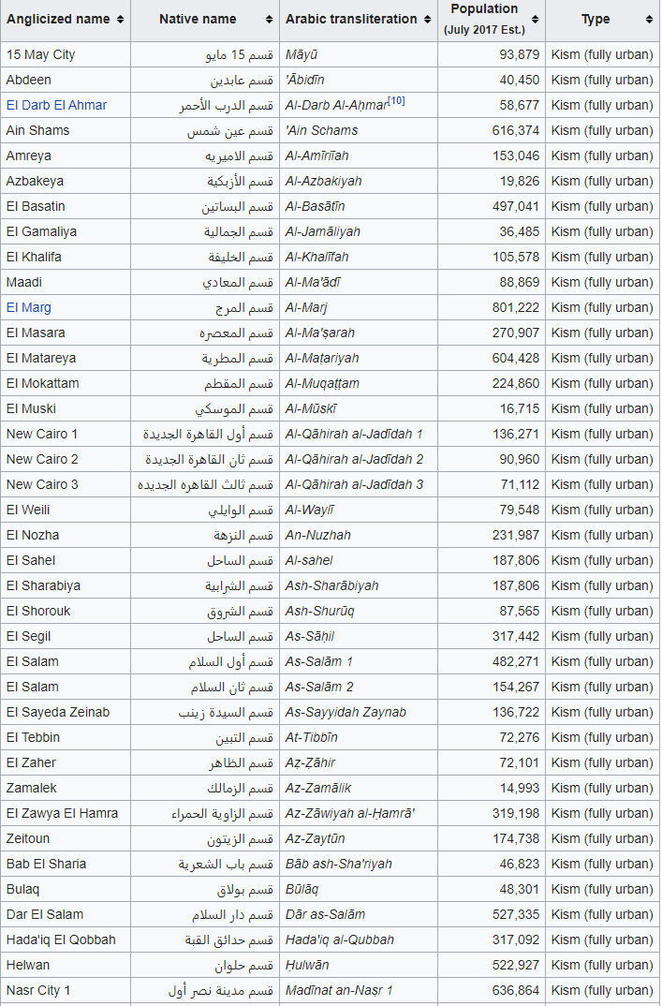
Scrapping The Data from Wikipedia for the Below Locations in Cairo and Giza :

Slide 7
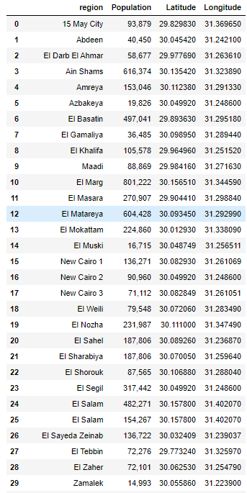
Getting the Coordinates for those Locations:

Slide 8
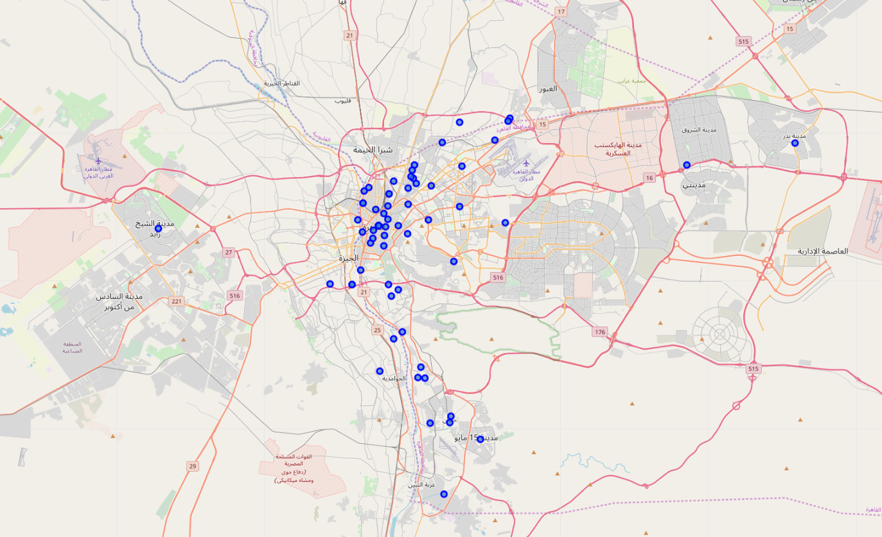
Superimposing the Regions on the Map:

Slide 9
Methodology

Slide 10
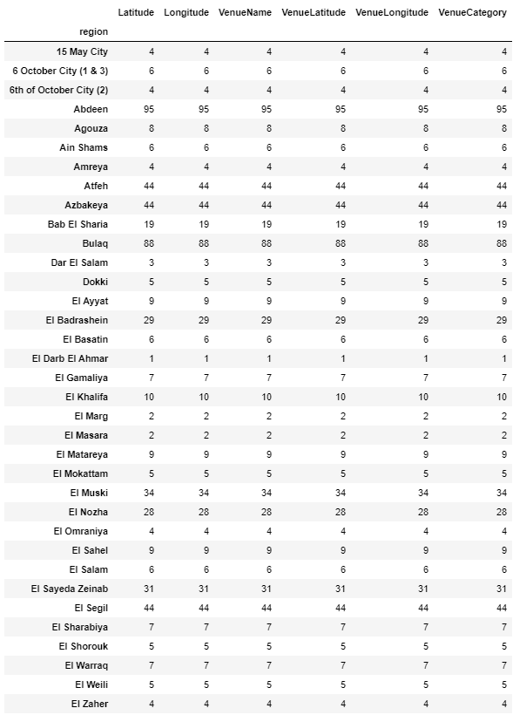
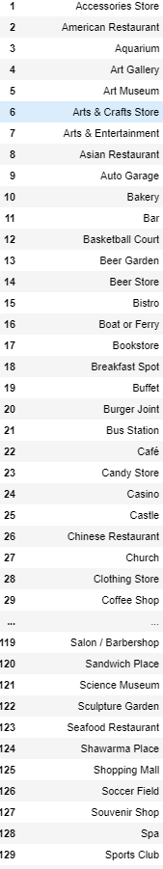
Getting the Venues numbers and Categories for each region:
Venues Categories

Slide 11
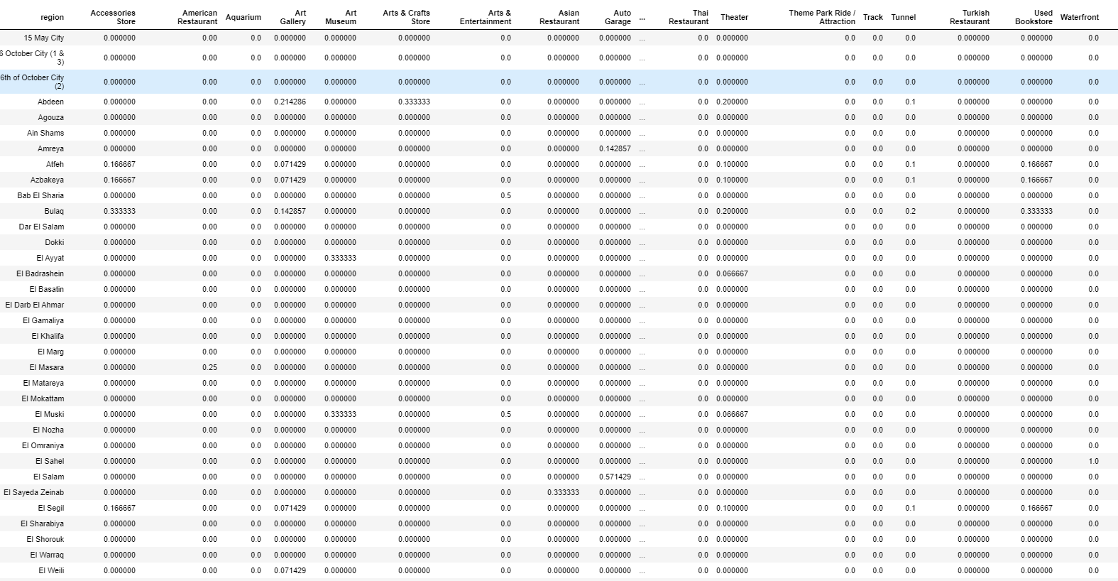
Getting the weightage for Each venue category per region by dividing the number of the venue category in each region by the total number of the venue category:

Slide 12
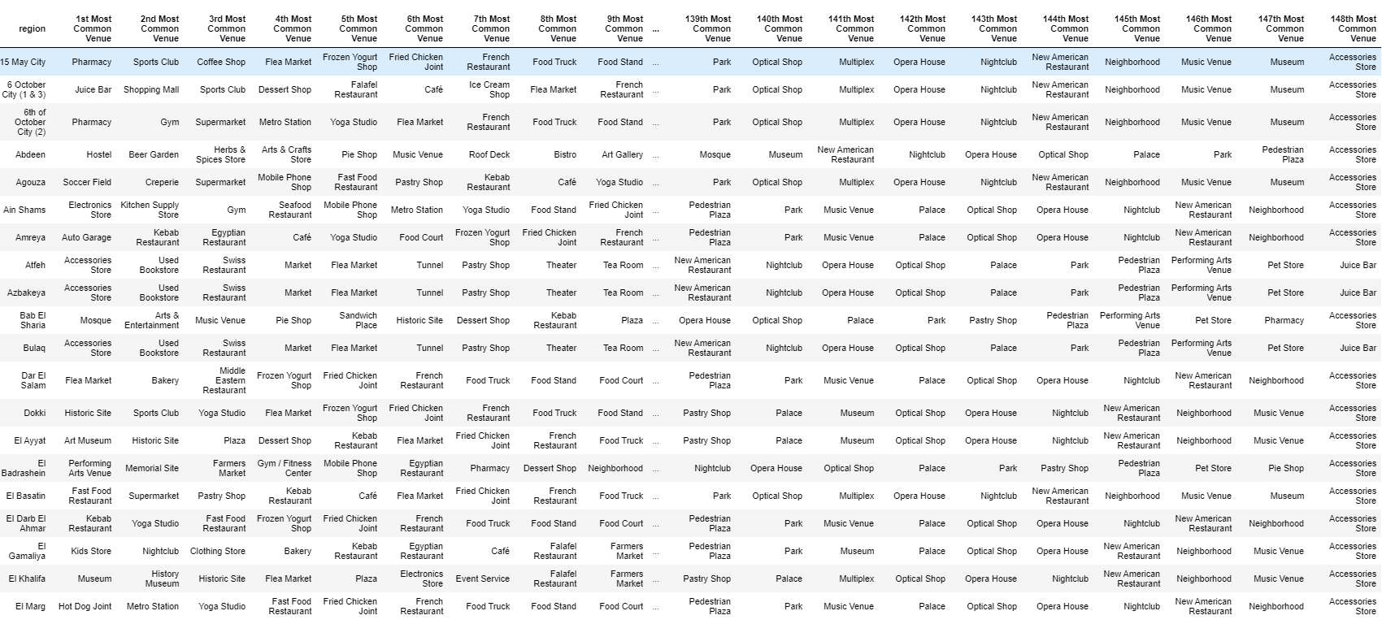
The Most Common venue per each region sorted Horizontally:

Slide 13
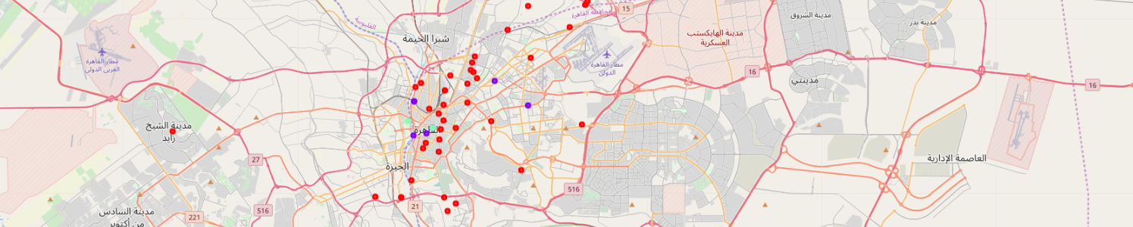
Selecting the Coffee Shop to be our Category and dividing the regions to three Clusters according to the total number of Coffee shops in each region and superimposing on the map:

Slide 14
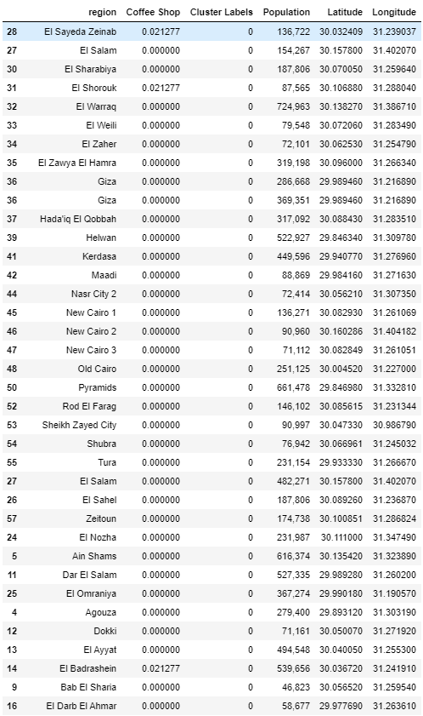
First Cluster (in red):the regions with least number(Weight) of Coffee Shops and the highest Population Density:

Slide 15
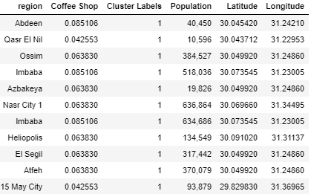
Second Cluster (in purple): the regions with Moderate number(Wight) of Coffee Shops and the high Population Density

Slide 16
Third Cluster (in green): the regions with highest number(Weight) of Coffee Shops and the lowest Population Density

Slide 17
Results

Slide 18
The Best Choice is the regions in Cluster 1

